Slide 1
What factors determines a car’s selling price?
<George Lu>
Notes:
Please enter project details and your details here.
<number>

Slide 2
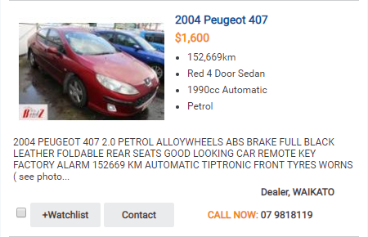
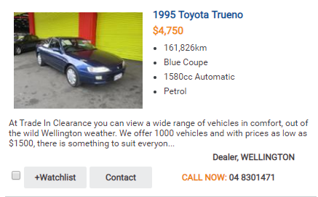
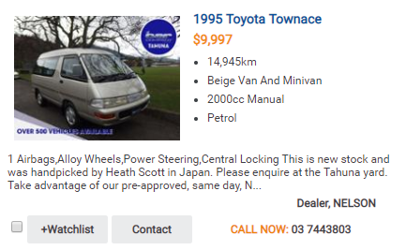
$$$ = ???
$$$ = ???
$$$ = ???

Slide 3
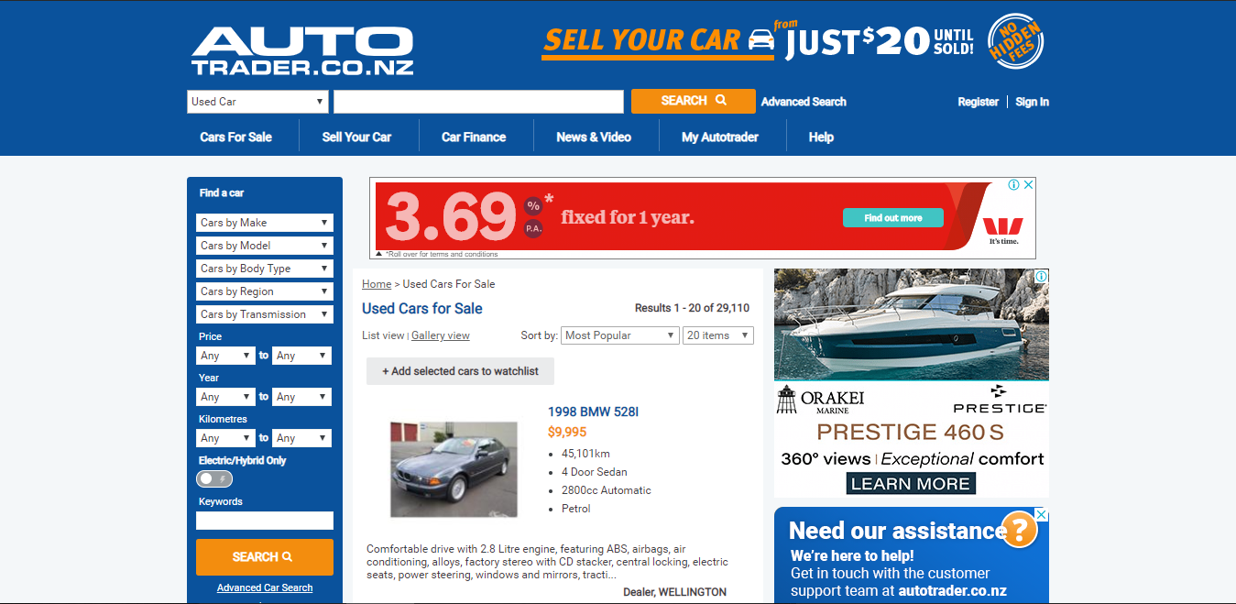

Slide 4
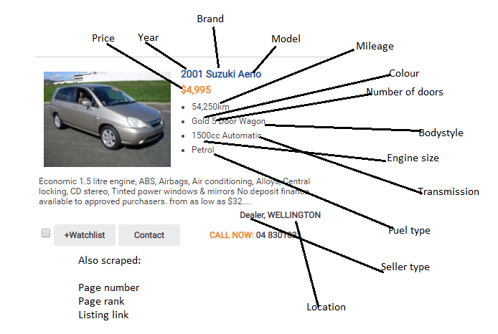
15,000 x

Slide 5
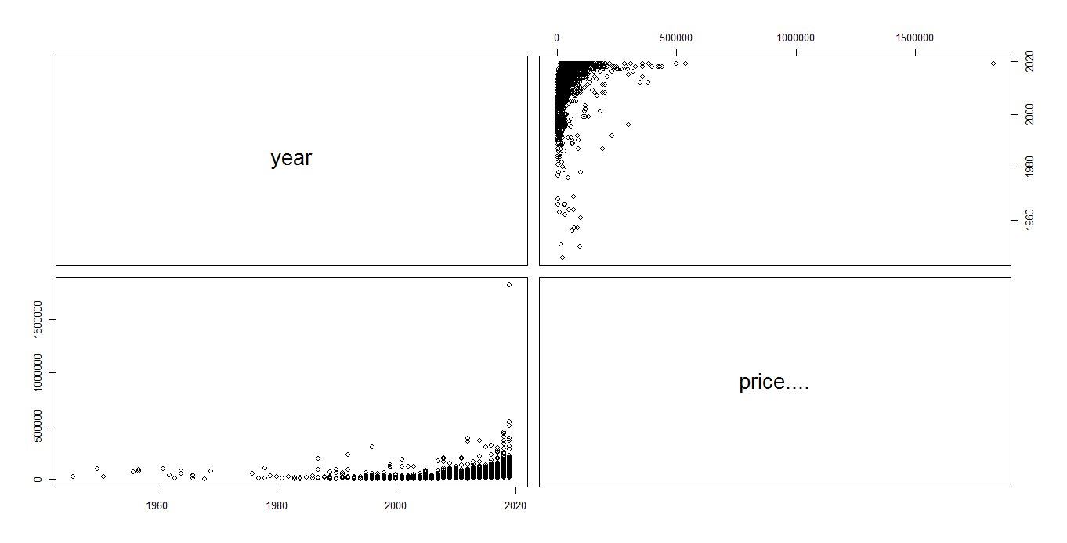

Slide 6
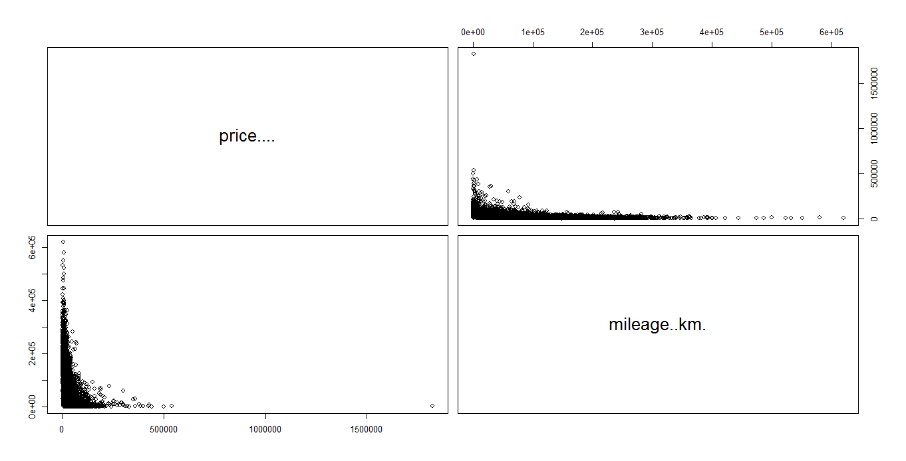

Slide 7
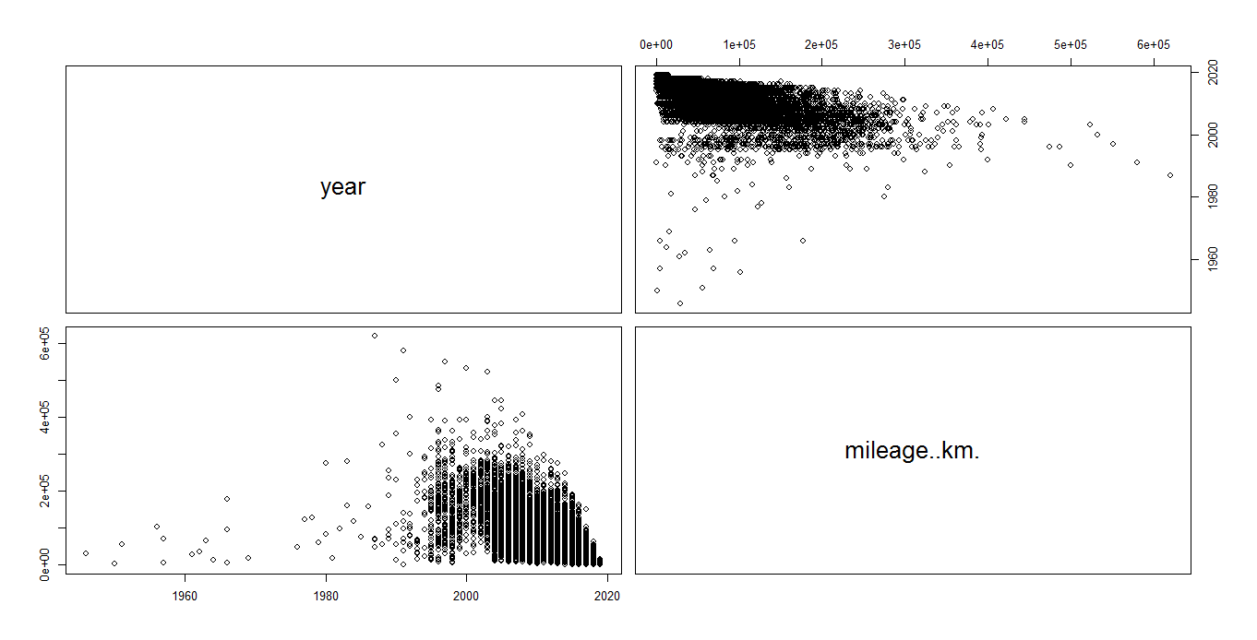

Slide 8
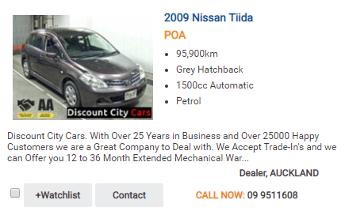
Removed listings

Slide 9

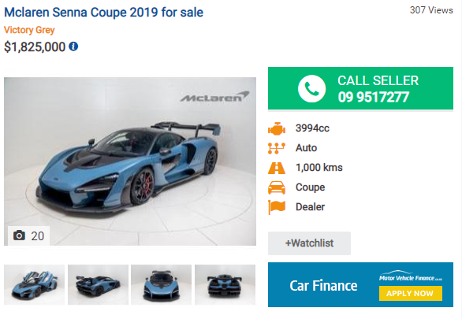

Removed listings

Slide 10
Categorical Variables

Slide 11
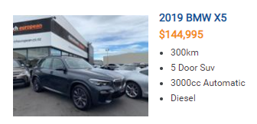
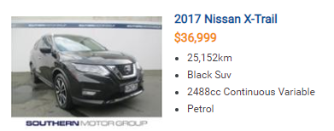
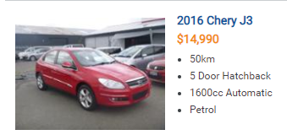
Market Segment
Determined by average price of listings in last 7 years
Luxury: > $150,000
Prestige > $90,000
Premium > $50,000
Mid Level > $40,000
Economy > $30,000
Entry level > $20,000
Budget > $10,000

Slide 12
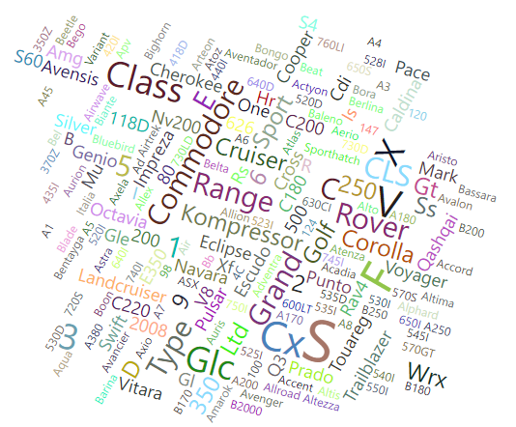
Models

Slide 13
Models

Slide 14
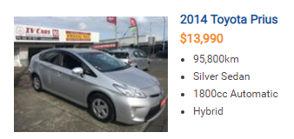
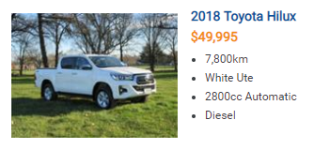
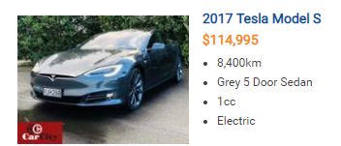
Fuel type
0
0.5
1

Slide 15
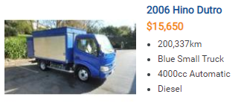
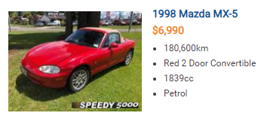
Bodystyle
Trade
Non-Trade

Slide 16
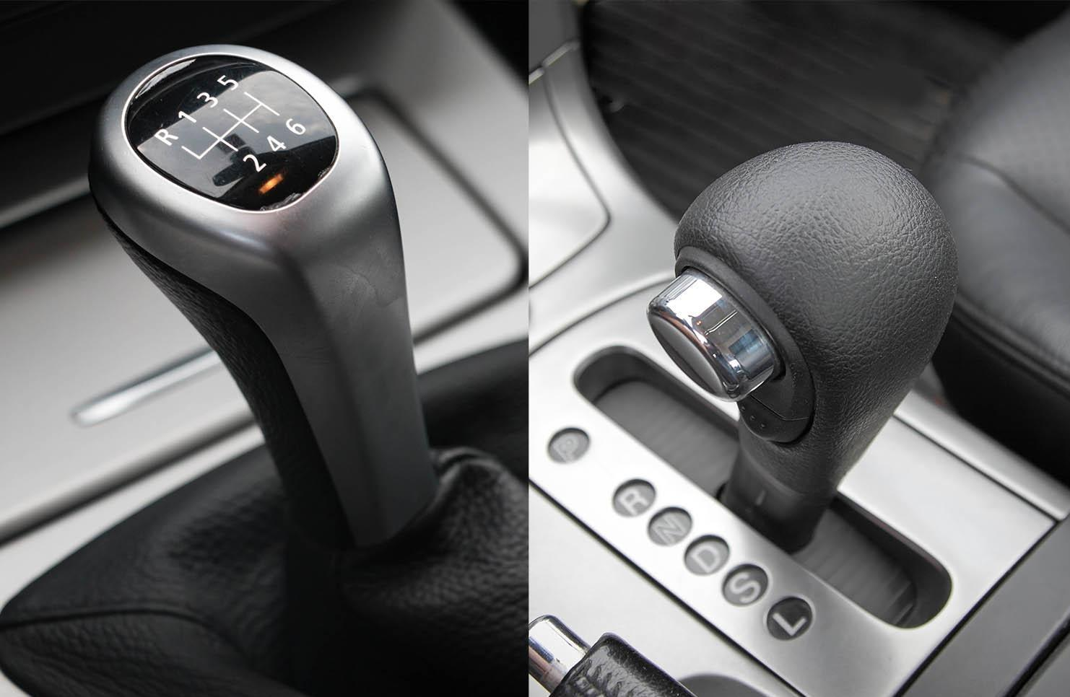
Transmission
Manual
Automatic

Slide 17
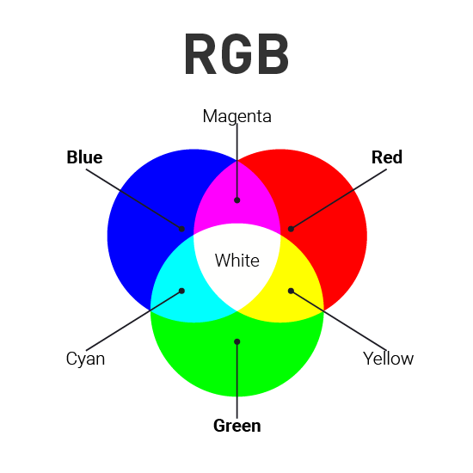

Colour

Slide 18
Colour

Slide 19
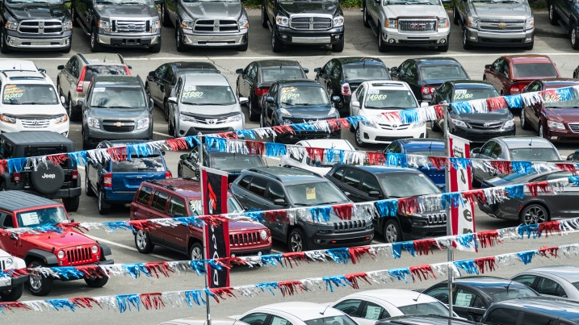

Seller type

Slide 20


Seller location
Location Size Scale:
> 1000000: "Auckland"
> 400000: "Large Region/City"
> 200000: "Moderately Large Region/City"
> 90000: "Normal Region/City“
< 90000: “Small Region/City“

Slide 21
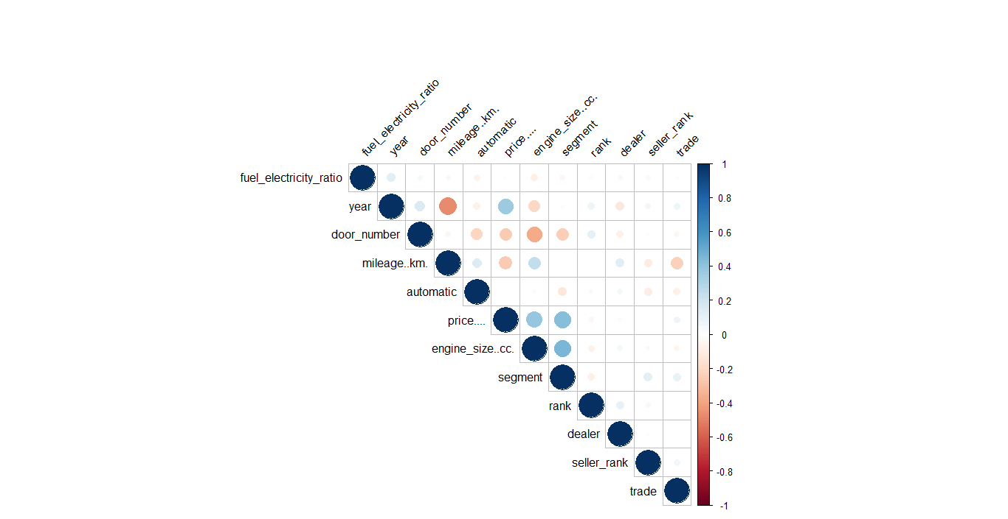

Slide 22
Variable subset selection

Slide 23
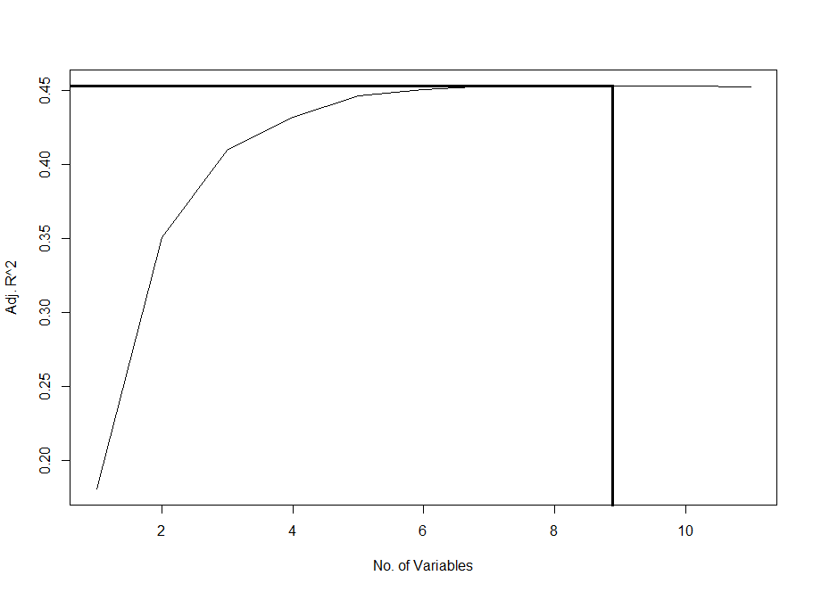

Slide 24
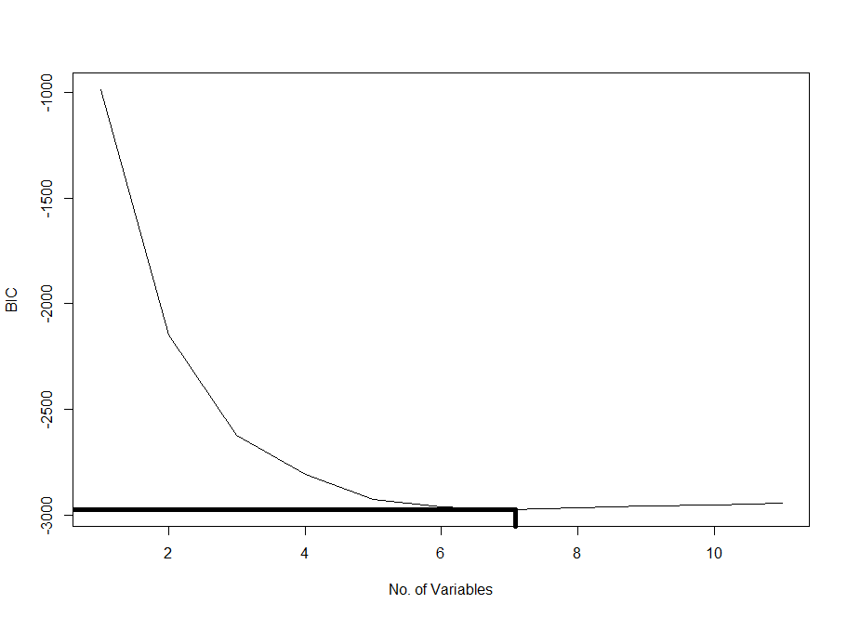

Slide 25


Slide 26
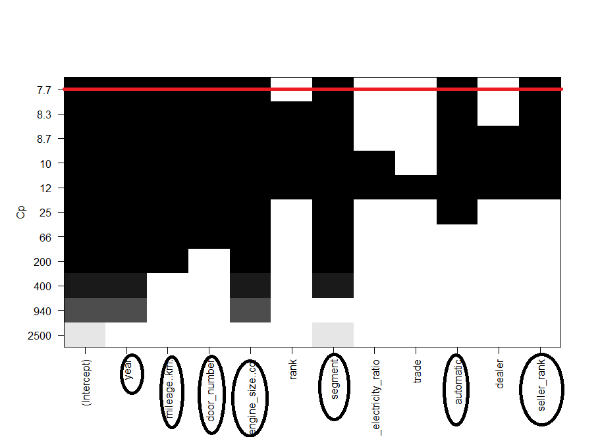

Slide 27
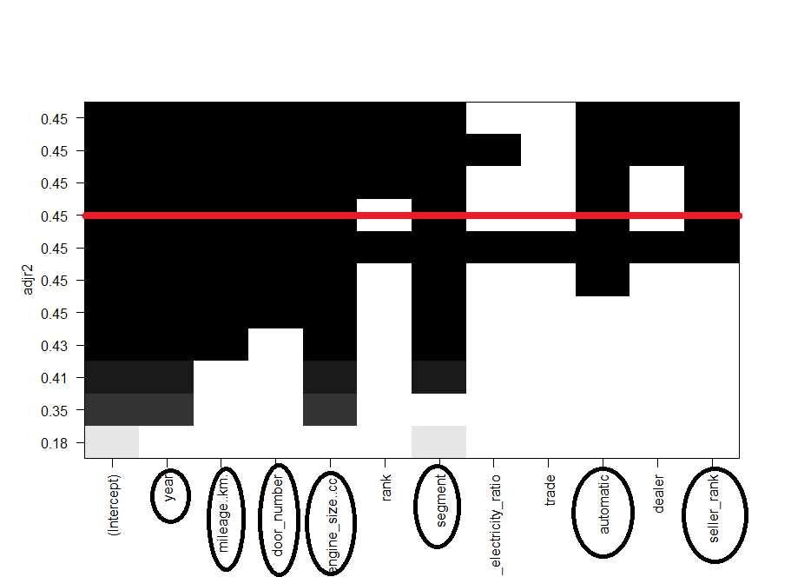

Slide 28
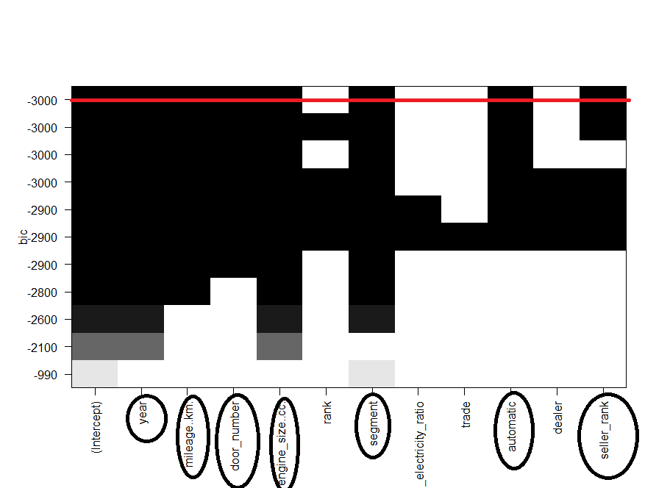

Slide 29
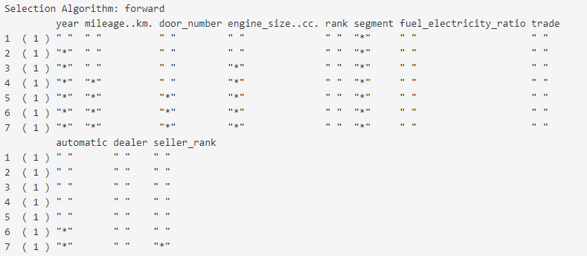

Slide 30
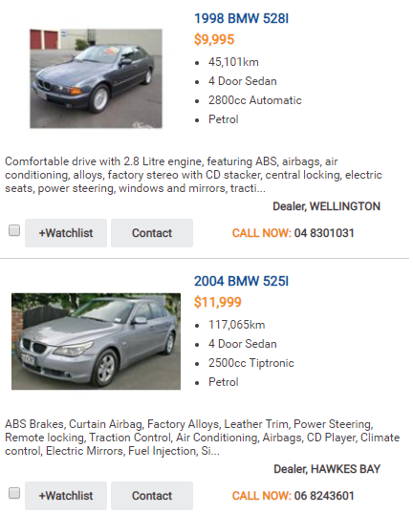
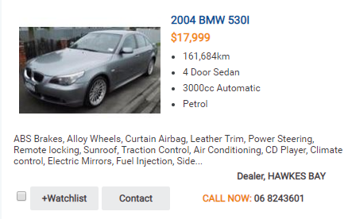
Popularity?

Slide 31
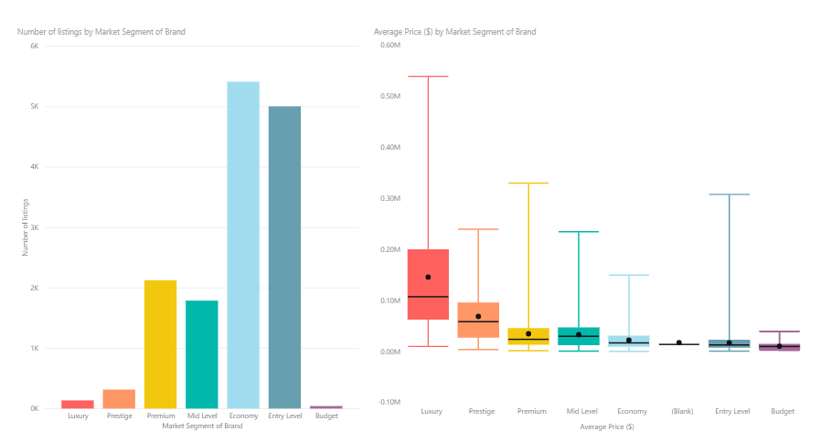
Power BI plots

Slide 32
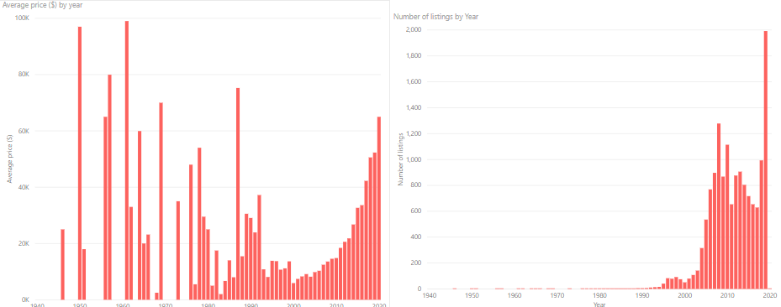

Slide 33
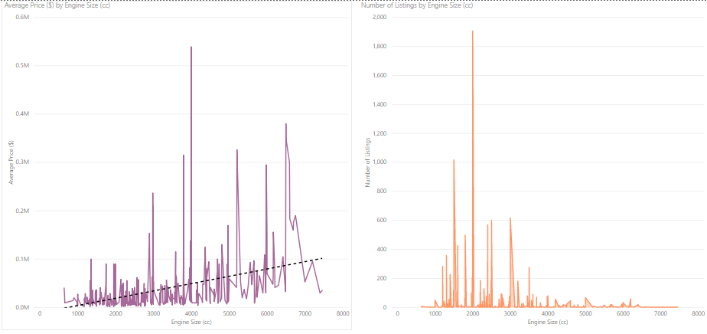

Slide 34
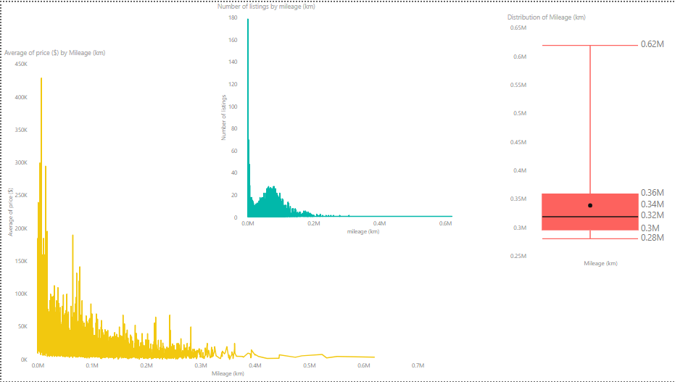

Slide 35
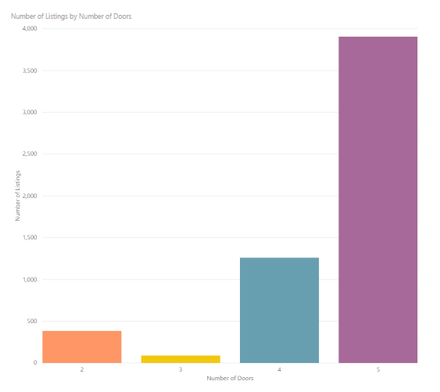
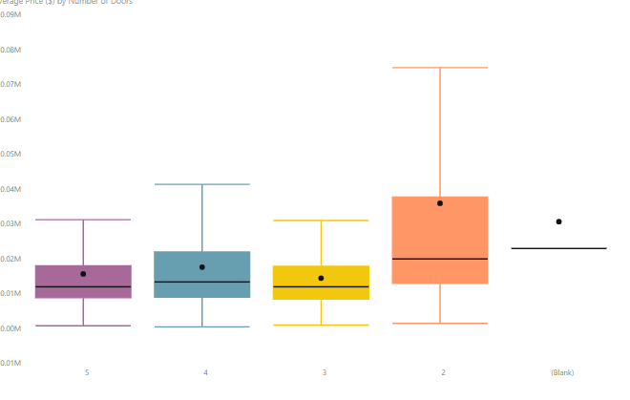

Slide 36
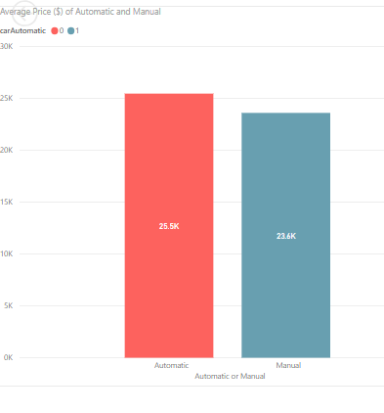

Slide 37
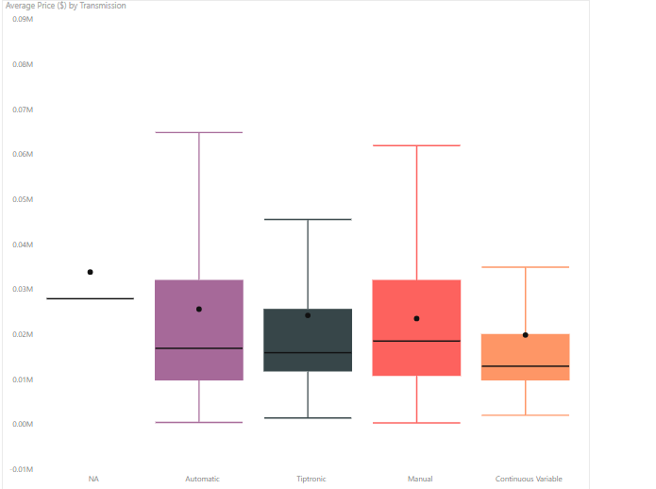

Slide 38
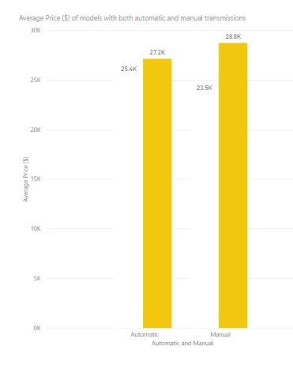

Slide 39
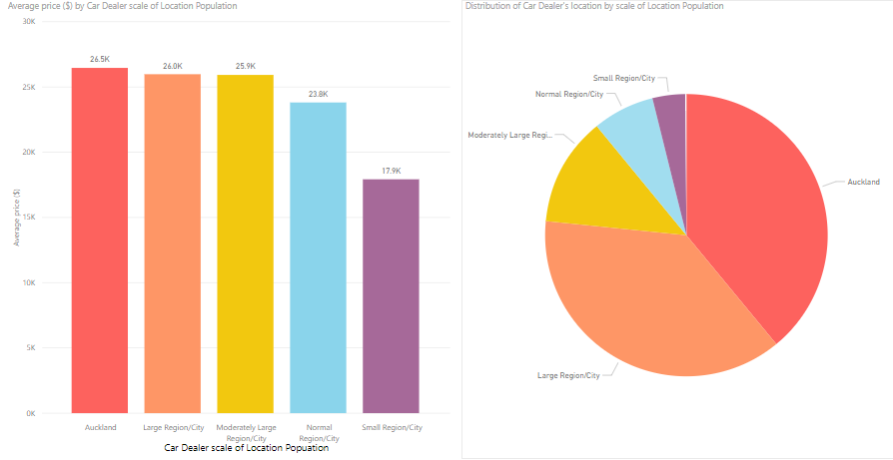

Slide 40
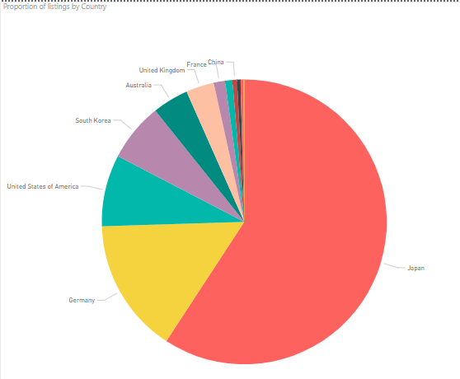

Slide 41
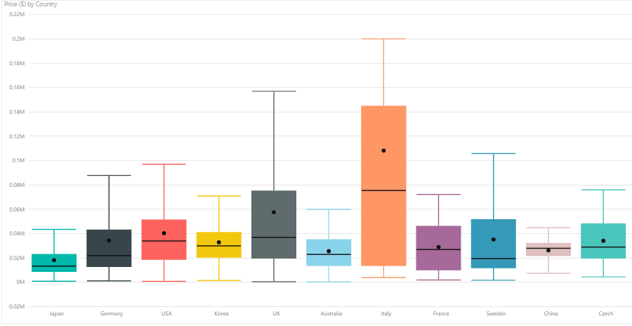

Slide 42
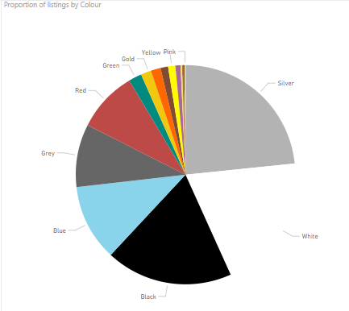

Slide 43
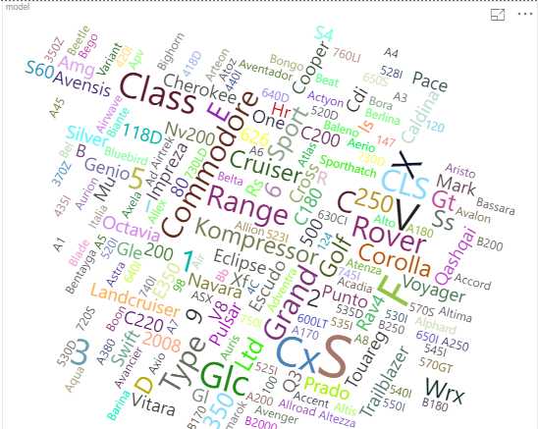

Slide 44

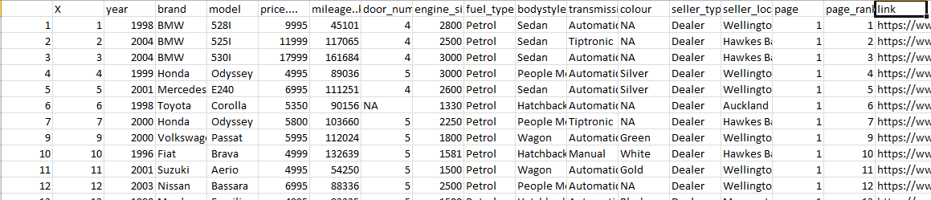
Advanced Features
Generate a dataset with more than 3,000 observations using web scraping techniques, each with 10 or more variables.

Slide 45
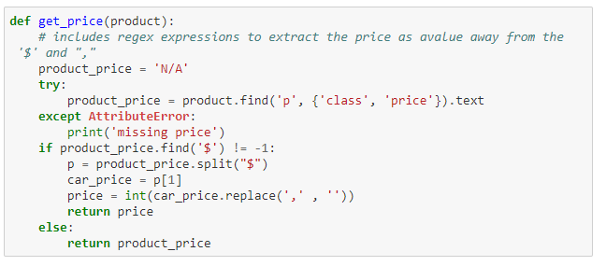
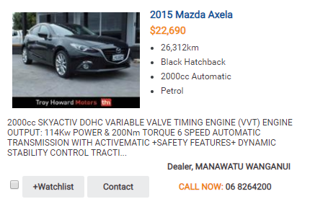
Advanced Features
At least three regular expression functions have been performed to extract information.

Slide 46
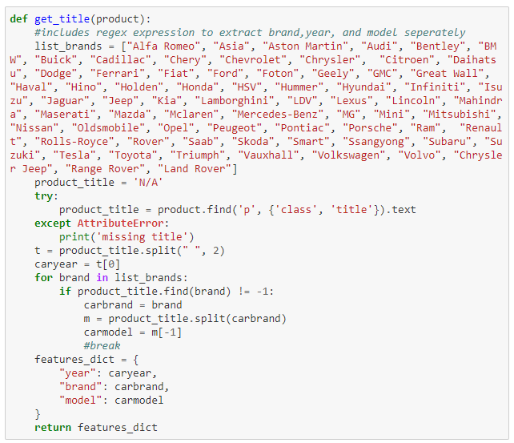
Advanced Features
At least three regular expression functions have been performed to extract information.

Slide 47
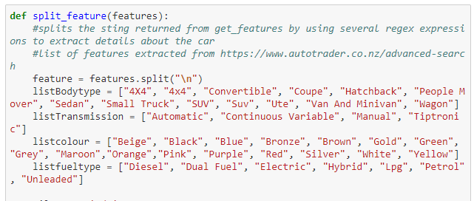
Advanced Features
At least three regular expression functions have been performed to extract information.

Slide 48

Advanced Features
Include at least three relational datasets in your Power BI reports.

Slide 49


Slide 50


Slide 51


Slide 52
Advanced Features
Use at least three DAX formula in your Power BI modelling.

Slide 53
Advanced Features
Use at least three DAX formula in your Power BI modelling.

Slide 54
Advanced Features
Use at least three DAX formula in your Power BI modelling.

Slide 55

Advanced Features
Use at least three DAX formula in your Power BI modelling.

Slide 56

Advanced Features
Use at least three DAX formula in your Power BI modelling.

Slide 57

Advanced Features
Use at least three DAX formula in your Power BI modelling.

Slide 58

Advanced Features
Use at least three DAX formula in your Power BI modelling.

Slide 59
Thanks for your time!
Q/A

